Slide 1

Viva Connections & SharePoint Framework Bi-weekly sync
aka.ms/m365pnp
Your host in this call: Patrick Rodgers
August 11th, 2022
Microsoft 365 PnP Team

Slide 2
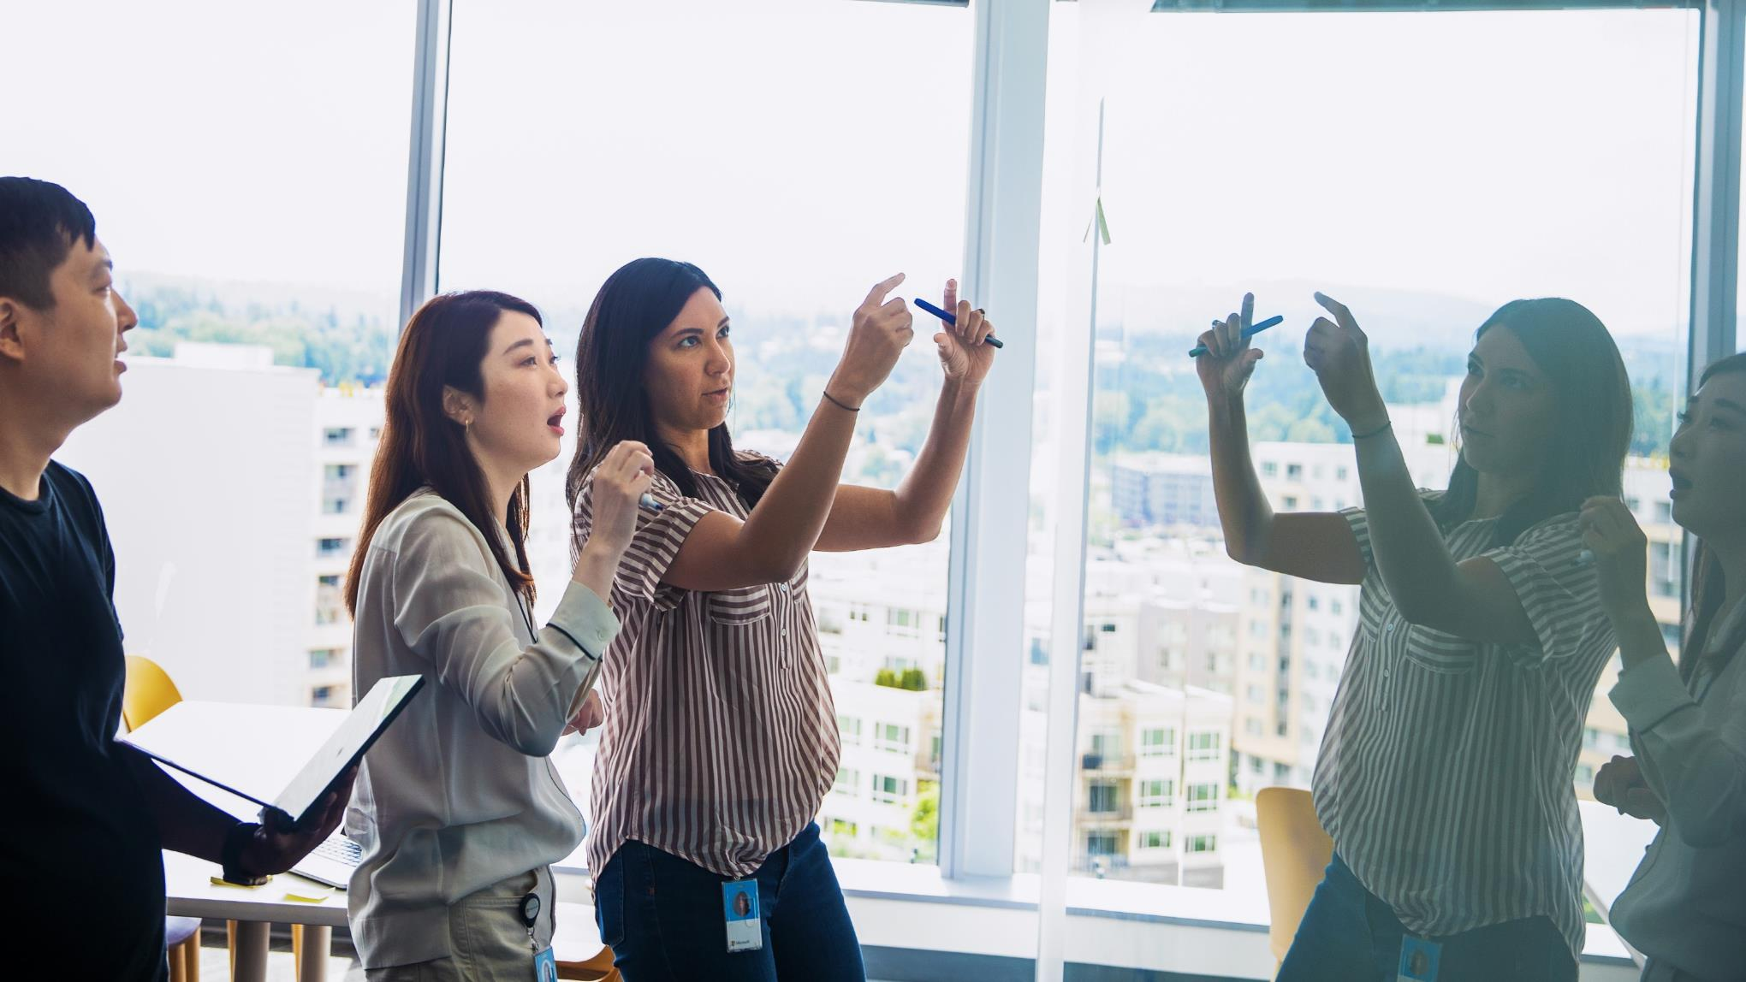



Agenda
Latest update on the SharePoint Framework
Patterns and Practices Updates
PnPjs
CLI for Microsoft 365
Reusable PnP SPFx controls
New Community Samples
Picture time with Together Mode!
Demos
Markus Möller – React Taxonomy File Explorer
Elio Struyf – Introduction to new Viva Connections Toolkit VS Code extension to streamline your development

Slide 3
Opportunities to Participate in PnP SPFx / JS SIG
SPFx Demo
@pnp Demo
Contribute on GitHub
Provide Feedback
Web Part
Application Customizer
Provisioning
Anything you create!
PnPjs
CLI for Microsoft 365
SPFx Reusable Controls
SPFx Community Yeoman
Report Issues
Submit Pull Requests
Help with issues/questions
How are the calls?
Documentation needs?
Where can we help?
Positive is OK too!
Great opportunity to get visibility for you or your company. Demo sample or explain how you extend or customize SharePoint Online with live demo in your projects. Reach out to team for volunteering.
Request a demo spot on the call
https://aka.ms/m365pnp/request/demo

Slide 4
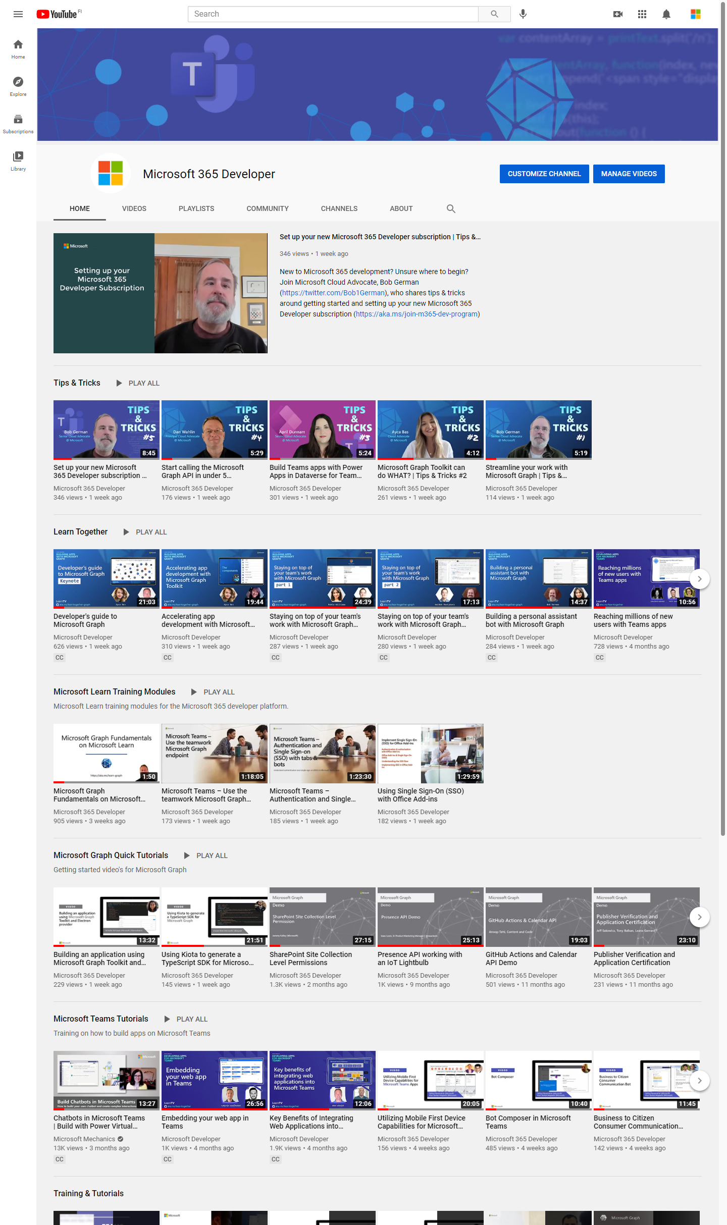
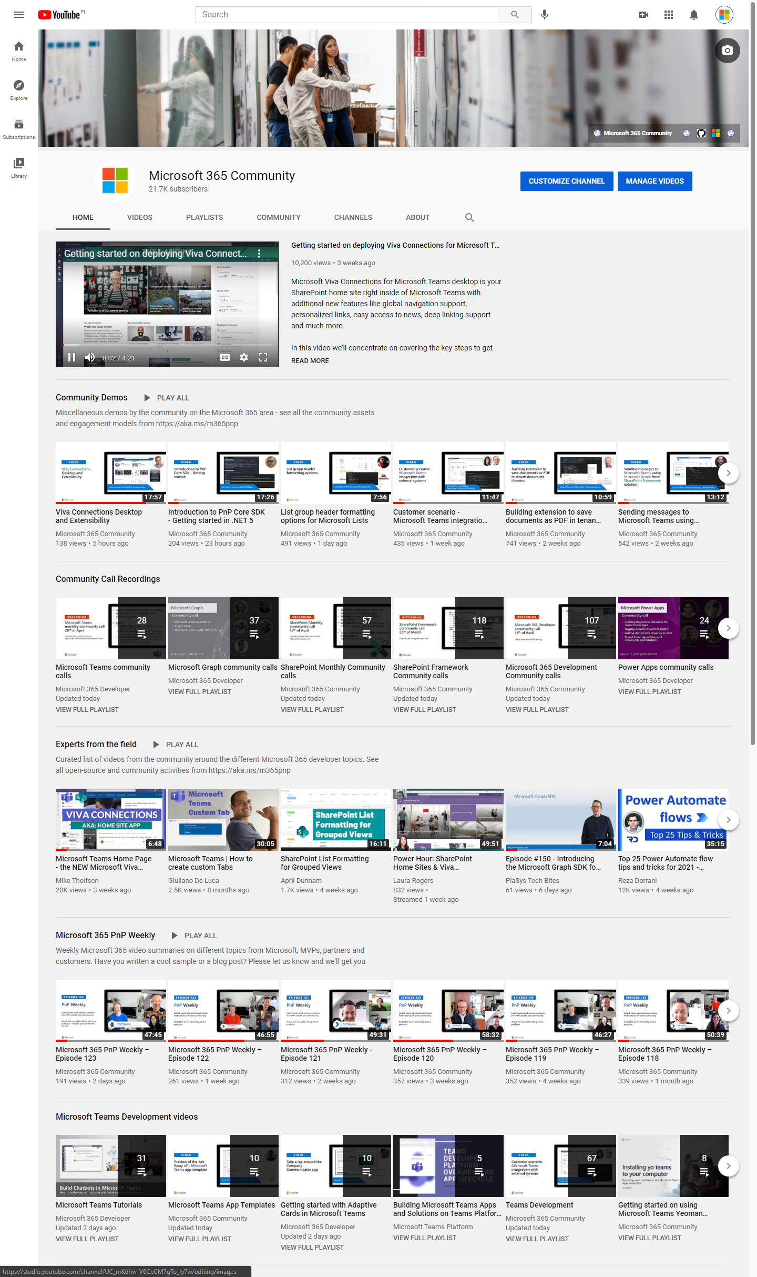
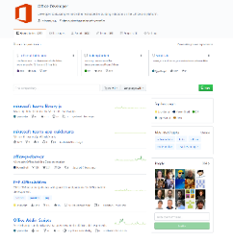
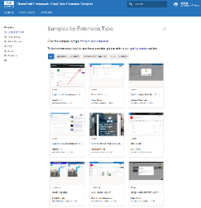
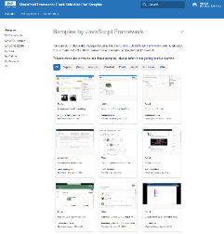
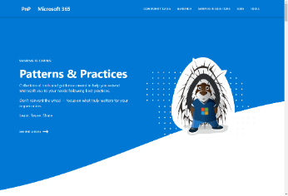
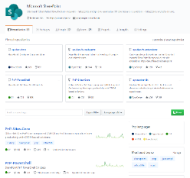
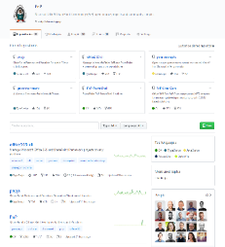
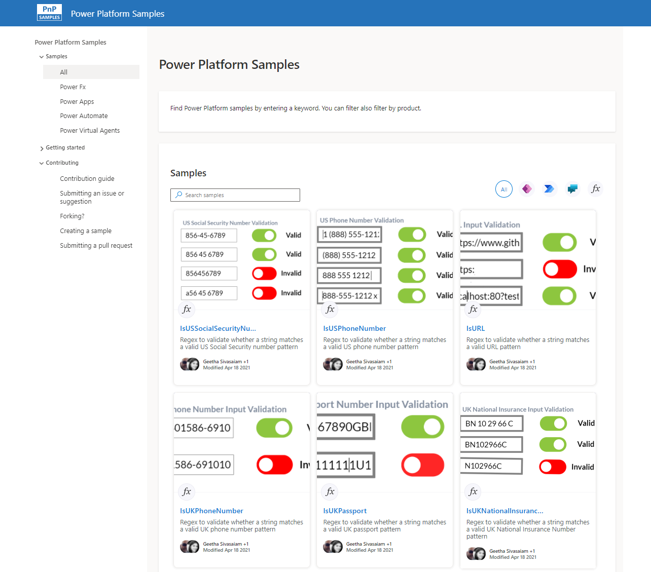
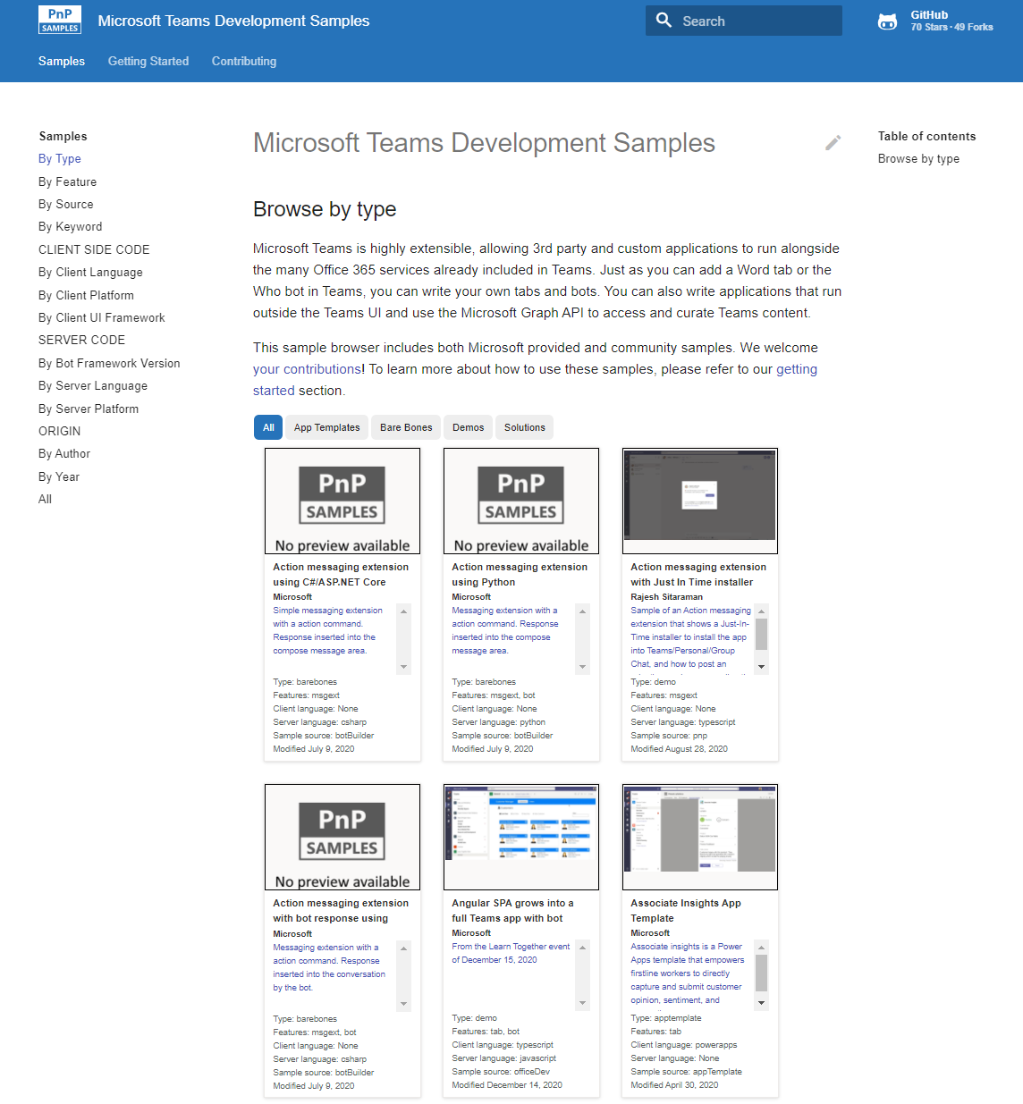
Microsoft 365 developer videos
Microsoft 365 community videos
Open-source
Sample galleries
Open-source initiatives and samples
aka.ms/m365devyoutube
aka.ms/m365/videos
github.com/pnp
github.com/officedev
github.com/microsoftgraph
github.com/sharepoint
aka.ms/m365/samples
aka.ms/teams-samples
aka.ms/spfx-webparts
aka.ms/spfx-aces
aka.ms/powerplatform-samples
aka.ms/spfx-extensions
aka.ms/list-formatting
aka.ms/m365/community
@Microsoft365Dev | @m365pnp
One URL to rule them all…

Slide 5
Microsoft 365 developer community calls
Microsoft 365 platform (weekly) https://aka.ms/m365-dev-call
(Notice. This call is on a summer break between July 1st and 31st of August 2022)
Adaptive Cards https://aka.ms/adaptivecardscommunitycall
Microsoft identity platform https://aka.ms/IDDevCommunityCalendar
Office Add-ins https://aka.ms/officeaddinscommunitycall
Power Platform https://aka.ms/PowerPlatformCommunityCall
Microsoft 365 and Power Platform community (bi-weekly) https://aka.ms/m365-dev-sig
Viva Connections & SharePoint Framework (bi-weekly) https://aka.ms/spfx-call
Download recurrent invites from
https://aka.ms/m365/calls
Notes:
m365-dev-sig

Slide 6
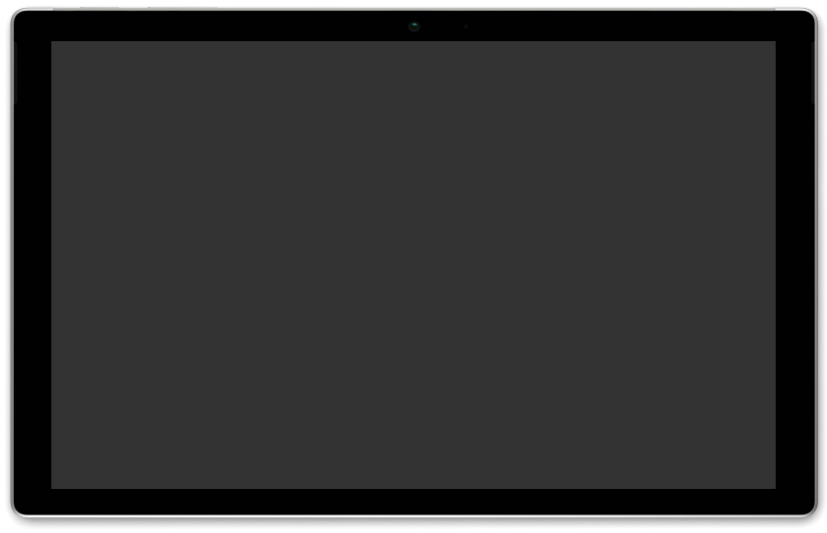
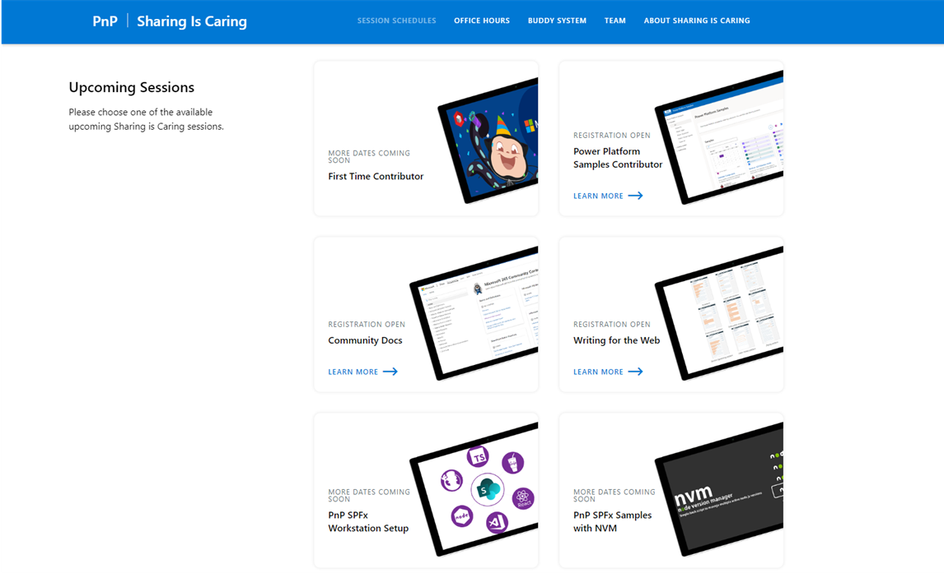
GUIDANCE
Learn how to get started in the open-source PnP community!
Upcoming Sessions:
First-time contributor
Community docs
Using PnP SPFx samples w/ NVM
SPFx developer workstation setup
More than code with VS Code
First-time presenter
M365 Maturity Model Practitioners
Power Platform Samples Contributor
Writing for the Web
August & September Dates
https://aka.ms/sharing-is-caring
Notes:
25 Total attendees, 16 attendees who attended both First-Time Contributors and Community Docs sessions.

Slide 7





COMMUNITY
Recognition Program
Showcase your contributions
Powered by Credly
More achievement levels coming soon
https://aka.ms/m365pnp-recognition
Notes:
25 Total attendees, 16 attendees who attended both First-Time Contributors and Community Docs sessions.

Slide 8
SharePoint Framework Latest from Microsoft engineering for Microsoft Viva, Microsoft Teams and SharePoint extensibility

Slide 9
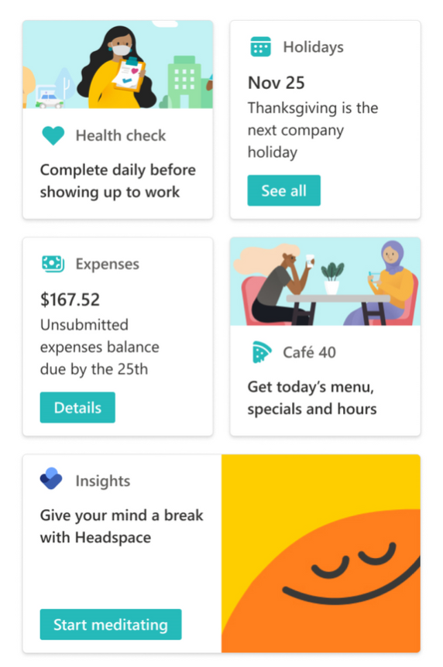
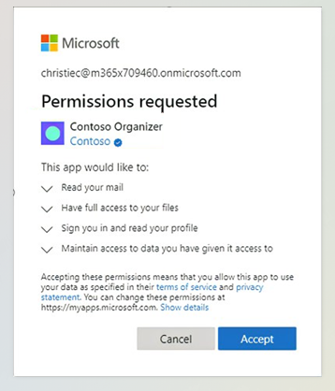
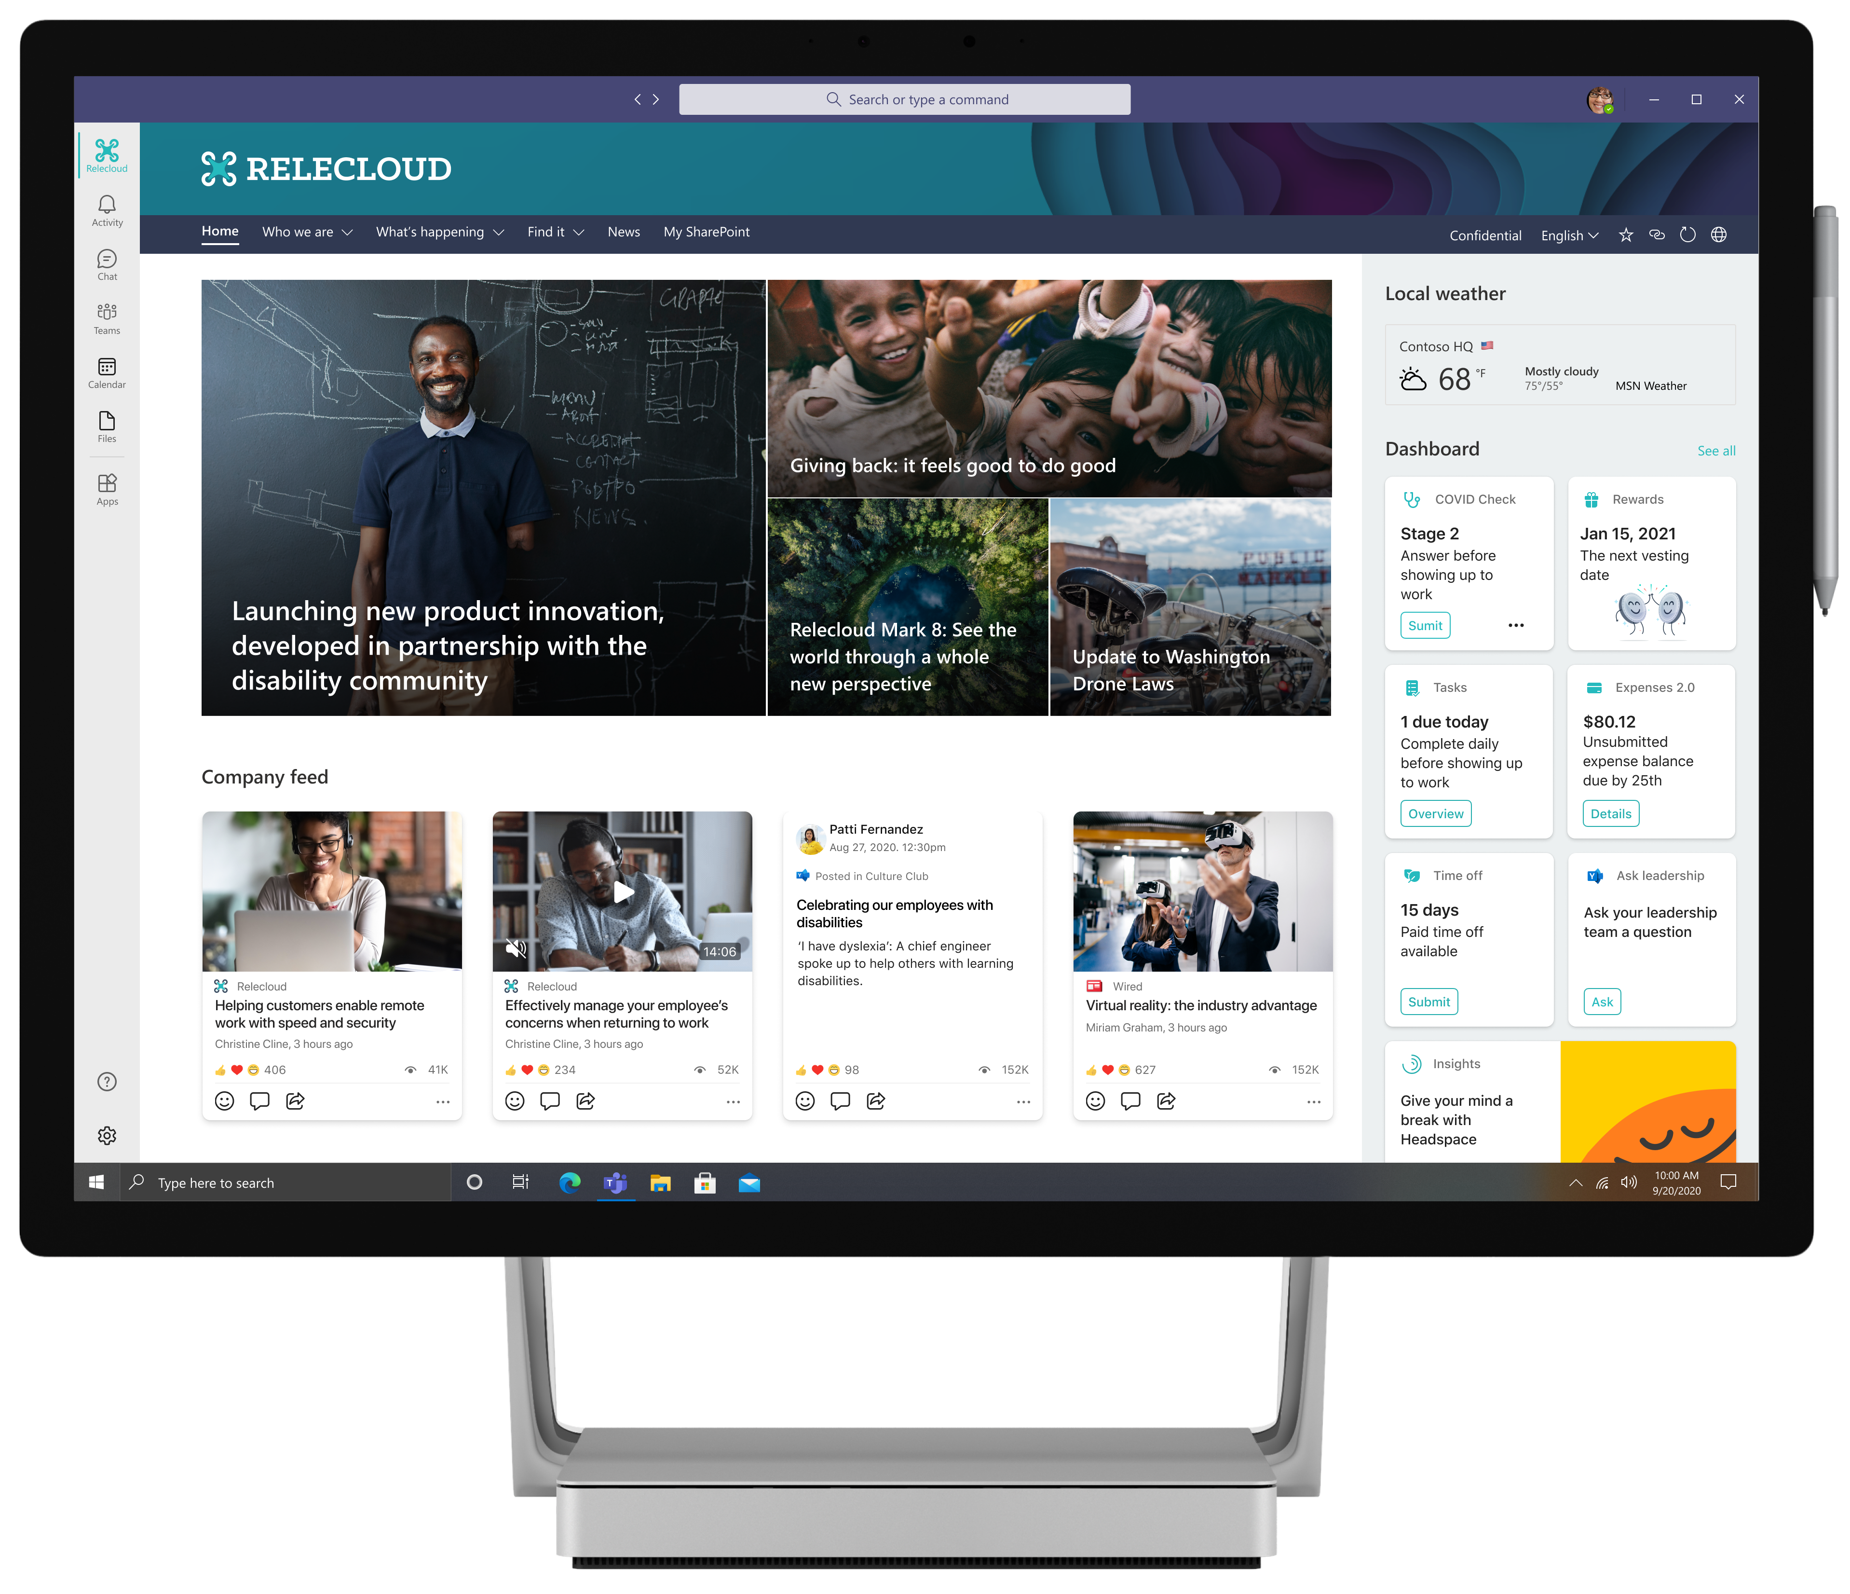
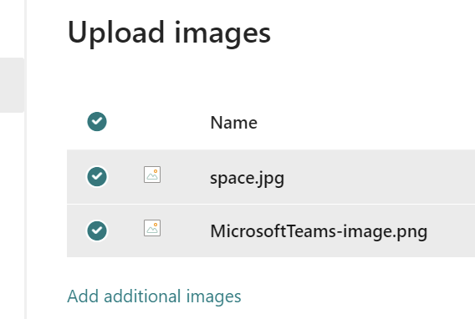




RELEASE
SharePoint Framework 1.15.2 now available!
New updated version of SharePoint Framework is now available with updated features for Microsoft Teams, Microsoft Viva and SharePoint Online
npm install -g @microsoft/generator-sharepoint@latest
Notes:
Dan’s slide

Slide 10
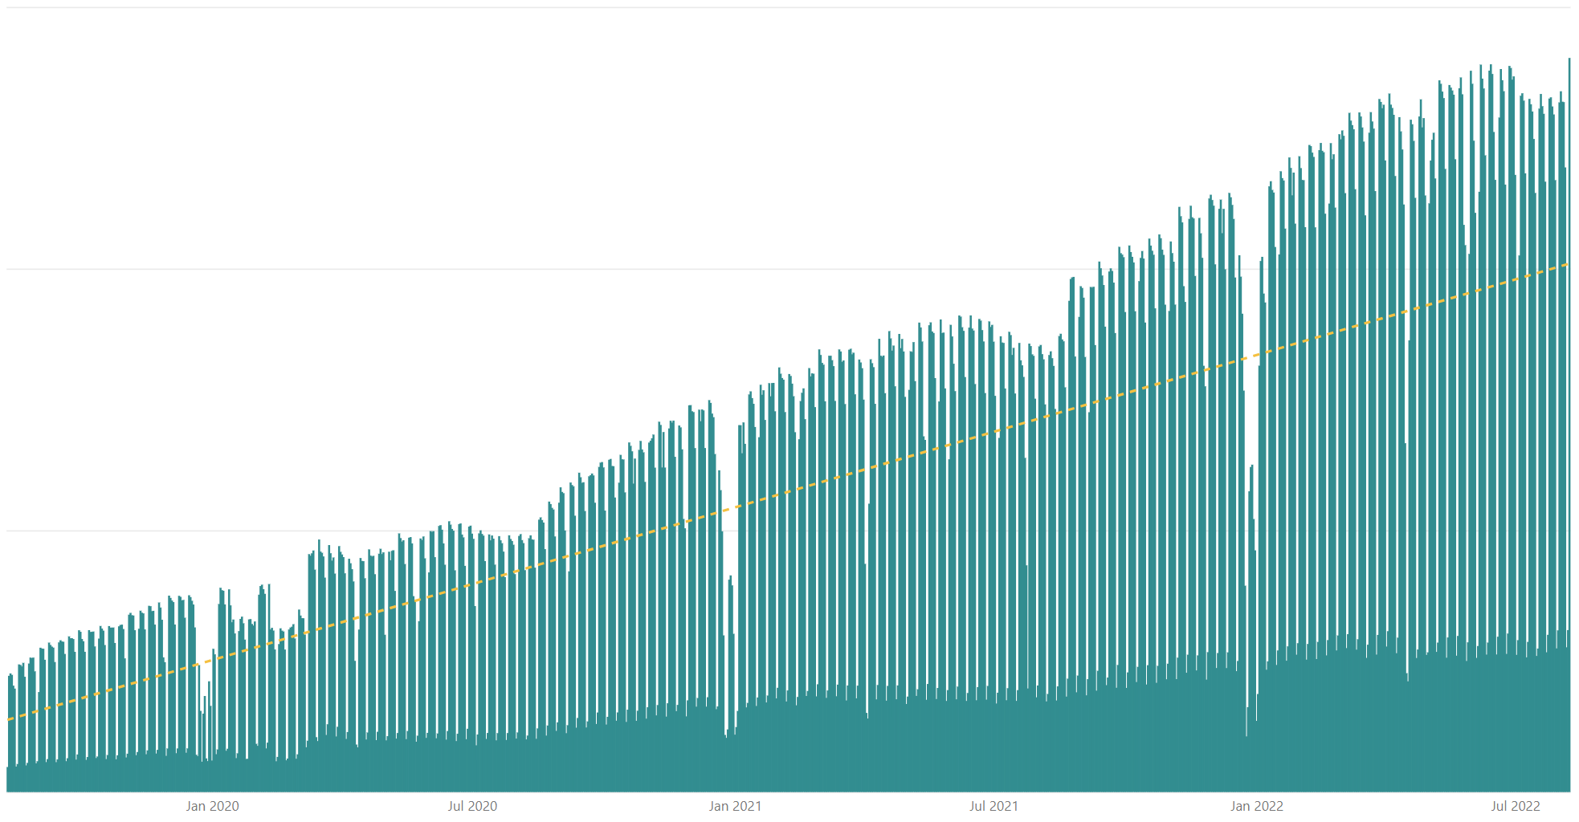

Rolling 28 days active users (MAU) for custom SharePoint Framework components in M365 There are currently tens of millions of monthly active users for customer and partner created SharePoint Framework components in Microsoft 365
All time highest usage in a day – Monday 8th of August 2022
Jan 2020
Jul 2020
Jan 2021
Jul 2021
Jan 2022
Jul 2022

Slide 11




The Road Ahead – SPFx roadmap
1.15.2 – Released 2 weeks ago
Enable Service Principal Registration in app acquisition flow
New media action type for Viva Connections
ESLint support update based on community feedback
Bug fixes and adjustments based on GitHub issues
1.16 preview in late August (TBD)
Teams JavaScript SDK v2 native support in SPFx solutions
Bots Powered Adaptive Card Extensions (Beta)**
… and more… 🚀
1.16 General Availability in by end of 2022
1.17 ETA in December/January
and more across Microsoft Viva, Microsoft Teams and SharePoint

Slide 12

PnPjs Client-Side Libraries

Slide 13
























PnPjs Client-Side Libraries
Version 3.6 to be released Aug 12th
General documentation updates
Graph support for lists, content-types, columns
Update for URL encoding
Graph support for Special folders
Don’t forget about the nightly builds
npm install @pnp/sp@v3nightly --save
Docs: https://pnp.github.io/pnpjs/ @m365pnpjs on twitter

Slide 14
CLI for Microsoft 365

Slide 15
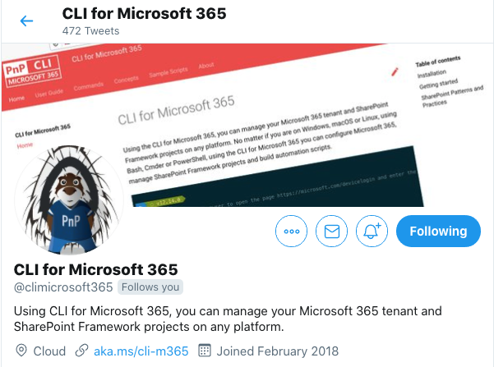
CLI for Microsoft 365
New v5.6 with:
Support for upgrading and validating SPFx projects to v1.15.2
Support for returning associated groups from SPO Groups
Support for renaming files stored in SharePoint
And more...
Install and run v5.6:
npm install -g @pnp/cli-microsoft365@latest
docker run --rm –it m365pnp/cli-microsoft365:latest
Release notes:
https://pnp.github.io/cli-microsoft365/about/release-notes/
@climicrosoft365 #CLIMicrosoft365 on Twitter
📖 aka.ms/cli-m365
🗣 github.com/pnp/cli-microsoft365/discussions
Notes:
Introduce yourself - "Hey everyone 👋 Its Garry here from the CLI team"
High level - ”We have just released a new minor version following the new minor release of SharePoint Framework, v5.6 of CLI for Microsoft 365"
Summary - "In this release we included support for upgrading and validating your SharePoint framework projects to v1.15.2, as well as enhancements to SharePoint Online commands plus general improvements and bug fixes."
CTA (engage) - "I have provided some links in the chat for you to access all the key resources surrounding this release"
CTA (check docs) - ”Please checkout the release announcement, which also includes examples of how to use some of the new features and also the release notes for further detail on what has included in this release"
CTA (install) - "If you want to use the latest version, you can install directly from npm, or alternatively use our Docker image to run CLI in a container using the latest tag"
CTA (follow us) - "If you want to keep up with the latest CLI announcements, I highly recommend that you can follow our Twitter account @climicrosoft365, if you are posting about us on social networks please use the hashtag CLIMicrosoft365"
CTA (feedback) - "If you have any feedback (both positive and negative) or ideas for new features that you'd like to see, then please checkout the GitHub repo, and either raise an issue or start a discussion, we would absolutely love to hear from you"
Closing (Thank you) - "Finally, thank you to all the contributors who made this release possible. That’s all for now, thank you"
📣 CLI for Microsoft 365 v5.5 (pnp.github.io)
📝 Release notes - CLI for Microsoft 365 (pnp.github.io)
⬆️ project upgrade - CLI for Microsoft 365 (pnp.github.io)
🏥 project doctor - CLI for Microsoft 365 (pnp.github.io)
📦 @pnp/cli-microsoft365 - npm (npmjs.com)
🐳 Run CLI in a Docker Container - CLI for Microsoft 365 (pnp.github.io)
💬 CLI for Microsoft 365 (@climicrosoft365) / Twitter
💻 pnp/cli-microsoft365: Manage Microsoft 365 and SharePoint Framework projects on any platform (github.com)

Slide 16
SPFx Reusable Components

Slide 17
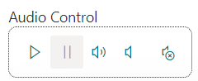
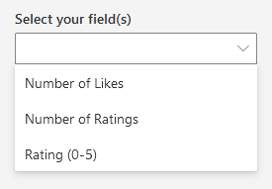
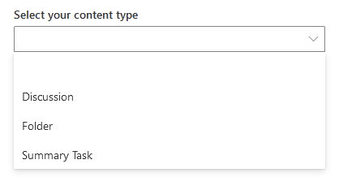
Reusable SPFx Controls
React Controls – 3.9.0
New controls: EnhancedThemeProvider, FieldPicker, ContentTypePicker, ModernAudio, AdaptiveCardDesignerHost
Enhancements to DateTimePicker, Toolbar, PeoplePicker, DynamicForm
Various fixes
Release notes: https://pnp.github.io/sp-dev-fx-controls-react/about/release-notes/
React Property Controls – 3.8.0
Localization for en-gb
Enhancements for fast-serve, PropertyFieldSitePicker, PropertyFieldCollectionData
Various fixes
Release notes: https://pnp.github.io/sp-dev-fx-property-controls/about/release-notes/
Update to SPFx 1.15.2 - work in progress
Special thanks to our contributors: Annie-Johnson, Daniel Watford, Dennis Kuhn, Fabio Franzini, Gautam Sheth, Jake Stanger, Jasey Waegebaert, Joseph Halvey, IRRDC, Markus Langer, Markus Möller, Milan Holemans, Morten Andersen, Peter Cox, Richard Gigan, Rico van de Ven, ryanexner, Sergio Villalta.
More information:
https://sharepoint.github.io/sp-dev-fx-property-controls https://sharepoint.github.io/sp-dev-fx-controls-react
Twitter: @M365PnPControls

Slide 18
PnP Modern Search

Slide 19
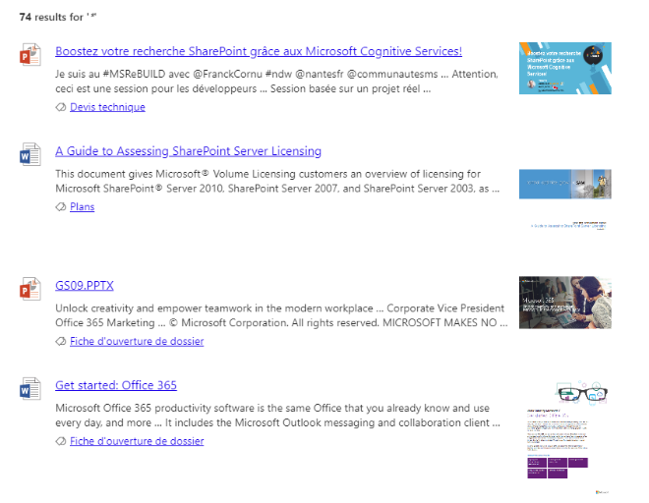

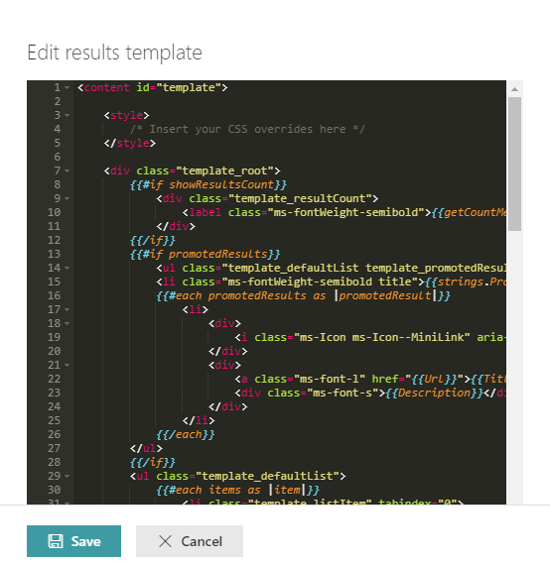
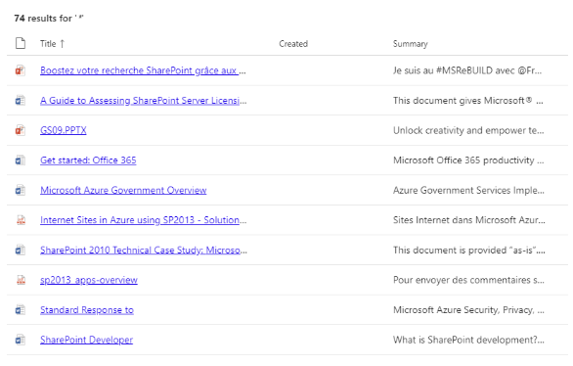

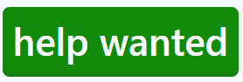
PnP Modern Search
http://aka.ms/pnp-search
Building modern Search experiences with flexible web parts
v4.7.0-beta – June 2022 release
https://github.com/microsoft-search/pnp-modern-search/releases/tag/4.7.0-beta
Thank you @d-martins, @bruzie, @rick-brown-slalom, @mrjarbenne, @davemehr for your support
Support for Adaptive Card rendering
See release notes for fixes and new features
v3.23.0 – December 2021 release
https://github.com/microsoft-search/pnp-modern-search/releases
See release notes for fixes and new features
Notes:
https://github.com/microsoft-search/pnp-modern-search

Slide 20

PnP SPFx Samples

Slide 21
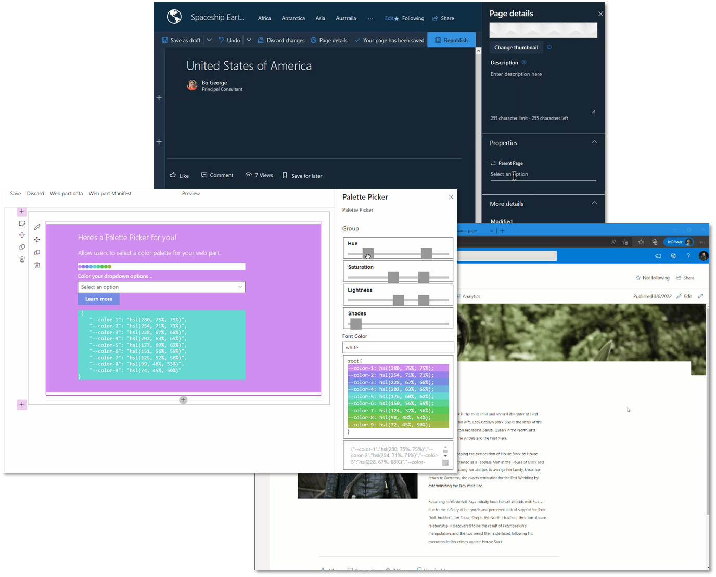
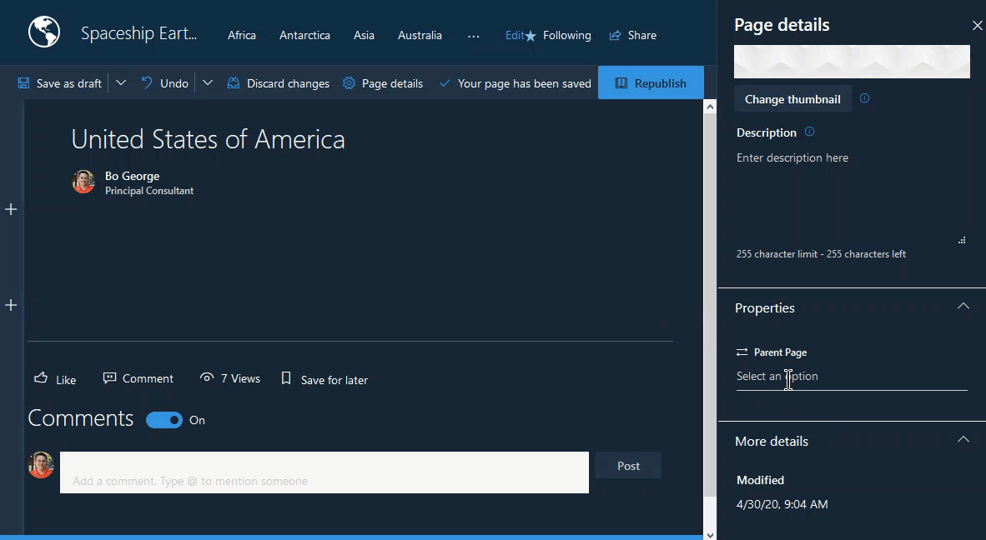
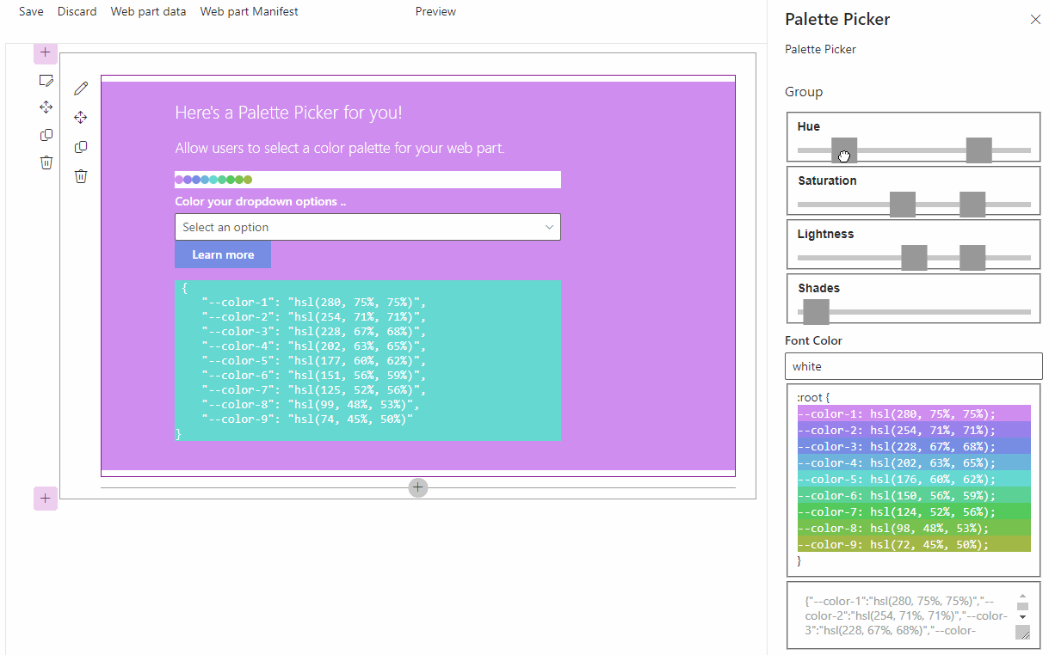
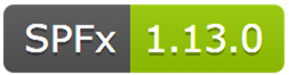
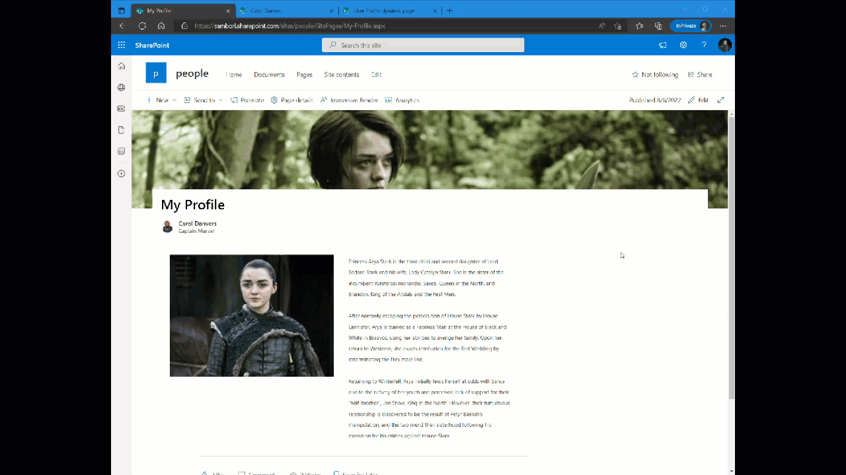
PnP SPFx Samples
PnP SPFx Samples
PnP SPFx Samples
https://aka.ms/spfx-extensions
https://aka.ms/spfx-webparts
Pages Hierarchy SlowRobot
My Awards Luis Manez | luismanez
Palette Picker flowerbot
Follow Documents André Lage | @aaclage
Notes:
SPFx extensions https://aka.ms/spfx-extensions
NOPE
SPFx web parts https://aka.ms/spfx-webparts
Pages Hierarchy
SlowRobot Expanded the tree view to allow the view to:
Find the current pages highest ancestor when given a page id of zero
Expand the tree view with only the pages that occur in the ancestor history as well as the current page
https://github.com/pnp/sp-dev-fx-webparts/tree/main/samples/react-pages-hierarchy
My Awards Luis Manez | luismanez
can select the user you want to get their profile awards. You can select the user from different origins: People picker, Page environment variable, or current logged user. It also allows to render the awards using 2 different layouts (Card / List)
https://github.com/pnp/sp-dev-fx-webparts/tree/main/samples/react-graph-profile-awards
NEW: Palette Picker flowerbot
Custom Property Pane pain resolved (whew), color palette generator inspired by Jhey. Built it to get an understanding of Property Pane Portal and cuz I want to eventually build in a dynamic palette generator/css reader for my web parts.
https://github.com/pnp/sp-dev-fx-webparts/tree/main/samples/react-palette-picker

Slide 22
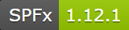
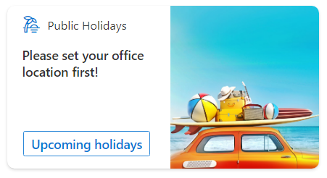
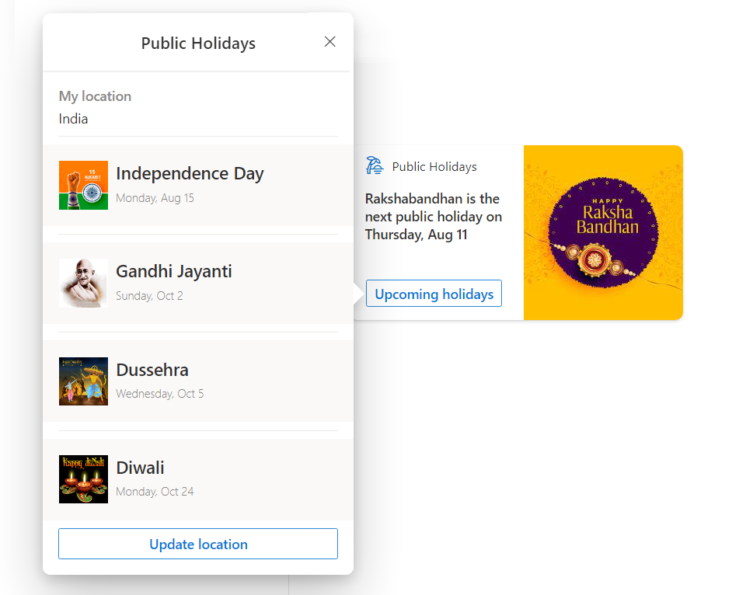
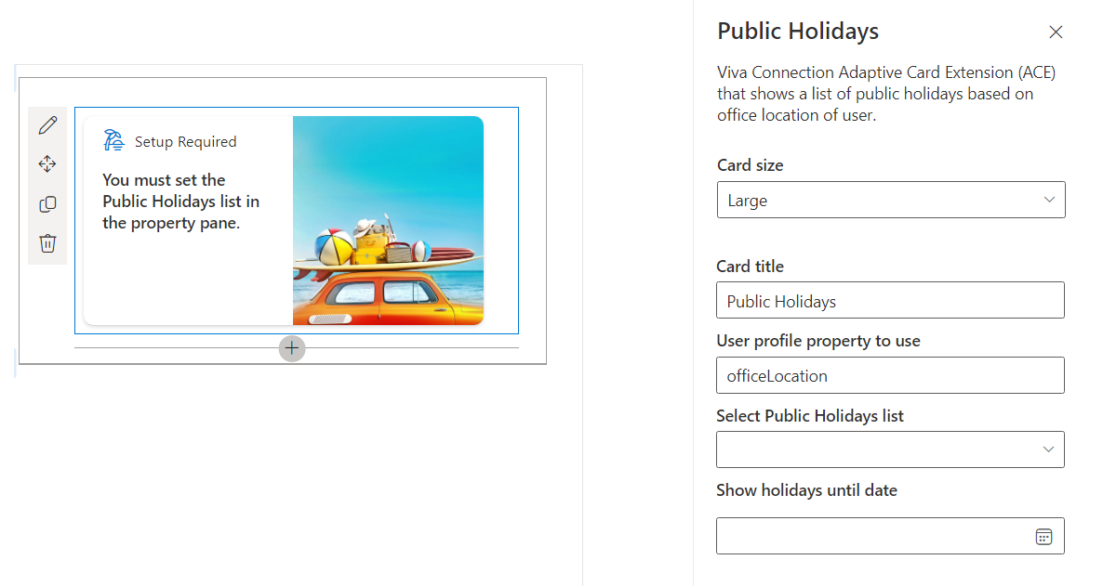
PnP SPFx ACEs
PnP SPFx Samples
PnP SPFx Samples
https://aka.ms/spfx-aces
Public Holidays Nanddeep Nachan | @NanddeepNachan
*** We Love New Samples ***
Follow Documents André Lage | @aaclage
Notes:
This adaptive card extension sample demonstrate ability to monitor security risks using identity protection graph api from Viva Connection Dashboard
SPFx extensions https://aka.ms/spfx-extensions
Copy/Move Items within Lists Sudharsan Kesavanarayanan | @sudharsank This application customizer will display a command button named Copy/Move Item(s) in all the custom lists. Using this option, the items can be copied or moved from one list to another within the site.
https://github.com/pnp/sp-dev-fx-extensions/tree/main/samples/react-command-copy-move-items
SPFx web parts https://aka.ms/spfx-webparts
Applications Secrets Expiration Aimery Thomas | @a1mery This sample web part shows the list of your applications registered in Azure AD along with their associated client secret/certificate expiration date. https://github.com/pnp/sp-dev-fx-webparts/tree/main/samples/react-graph-app-secret-expiration

Slide 23
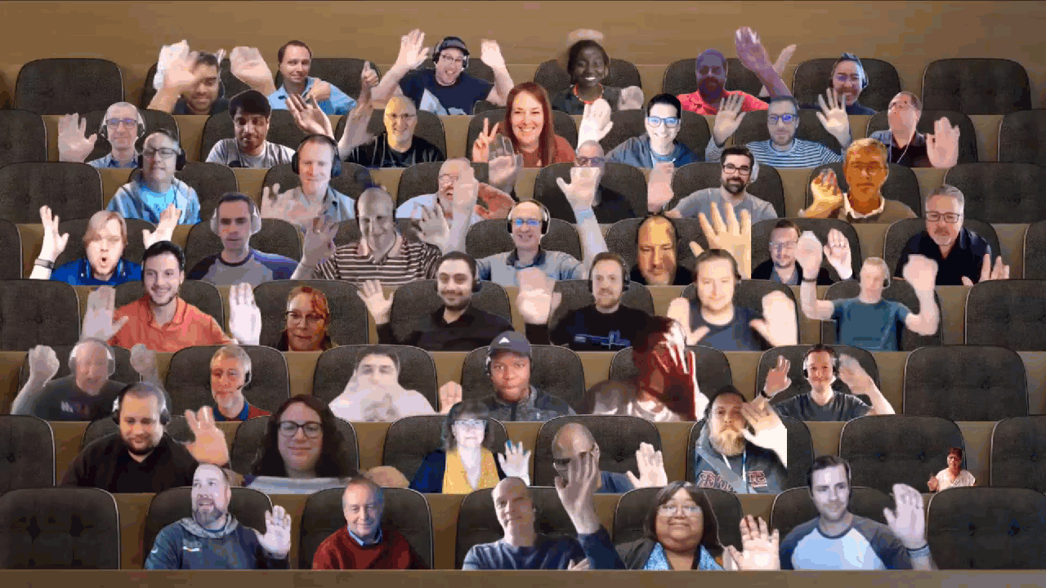

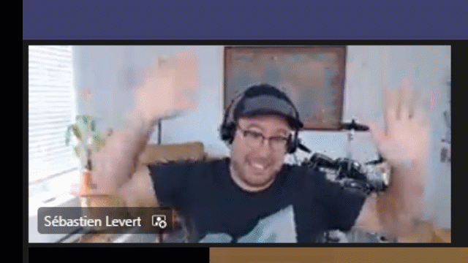
Optional picture time!
Video on and we’ll grab a Together Mode pic with those who are willing to do this.
We are together on this as a community!
Let’s all be like Seb?
By enabling your camera for the picture, you grant us permission to share your picture in social media.

Slide 24


DEMO
React Taxonomy File Explorer – Markus Möller
Introduction to new Viva Connections Toolkit VS Code extension to streamline your development – Elio Struyf

Slide 25
Thank you
Recording will be available in 24 hours on
Microsoft 365 Community (PnP) YouTube channel
https://aka.ms/M365/videos
(subscribe today)
Follow us on Twitter
@Microsoft365Dev | @M365PnP
Next Viva Connections & SPFx call: August 25th at 07:00am PT
Next M365 General Dev call: August 18th at 07:00am PT
All available community calls from https://aka.ms/m365/calls

Slide 26


aka.ms/m365pnp

